Slide 1

How to register your personal account on the ICASA website
Compiled by Rassie ZS1YT

Slide 2
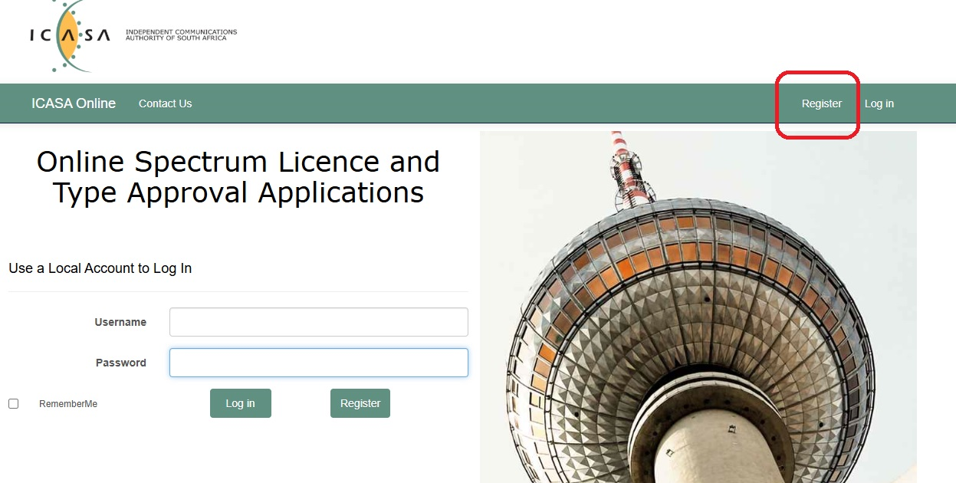
Open https://online.icasa.org.za/ which will open the page below and click on register

Slide 3
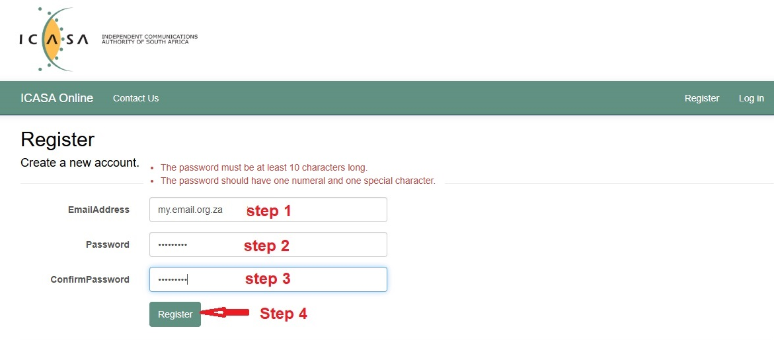
Enter your email address and select and confirm your password. See the password conditions in red.
Click on Register.

Slide 4
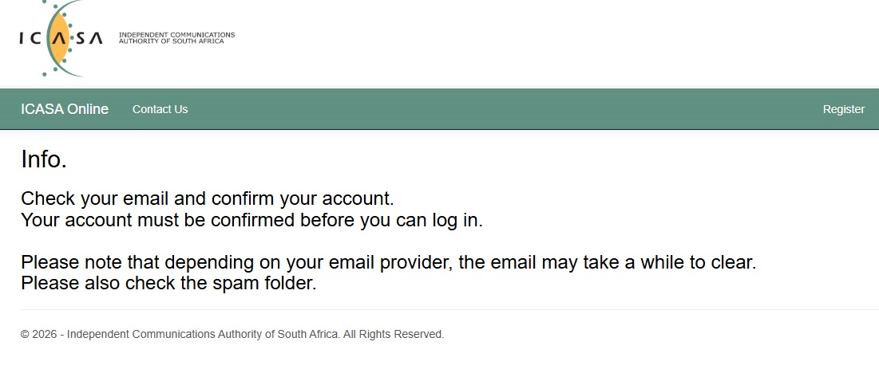
The following page will appear. Go to your email and confirm your account. (It may take a few minutes before the email will appear in your inbox.)

Slide 5
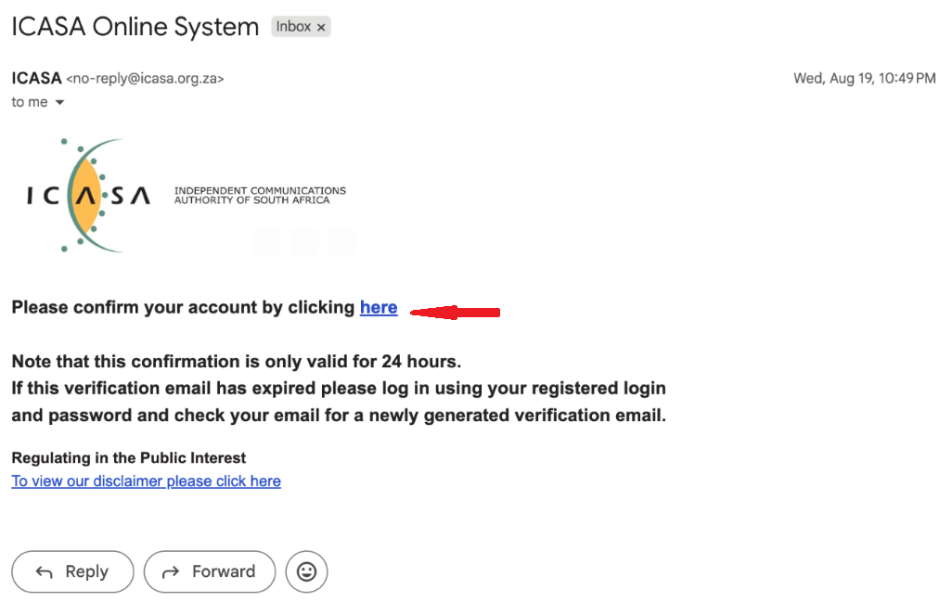
This is the typical email that you will receive. Just confirm your account.

Slide 6
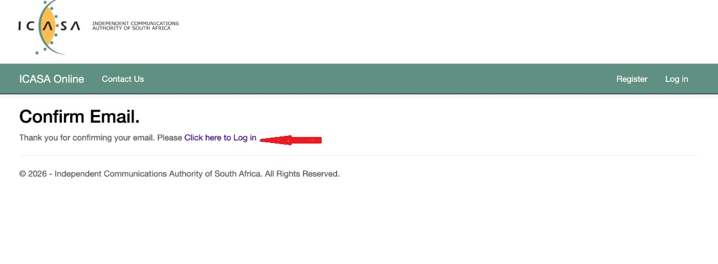
The following will now appear on the ICASA page and you can login to your account.

Slide 7
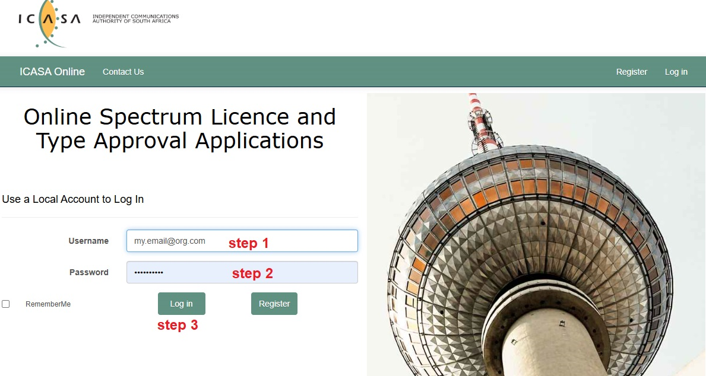
Once you have logged in you will be requested to enter your username and password. Then click on Log in.

Slide 8
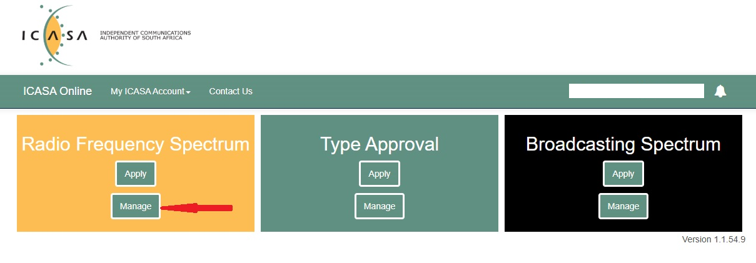
The following page will appear. Select “MANAGE”

Slide 9
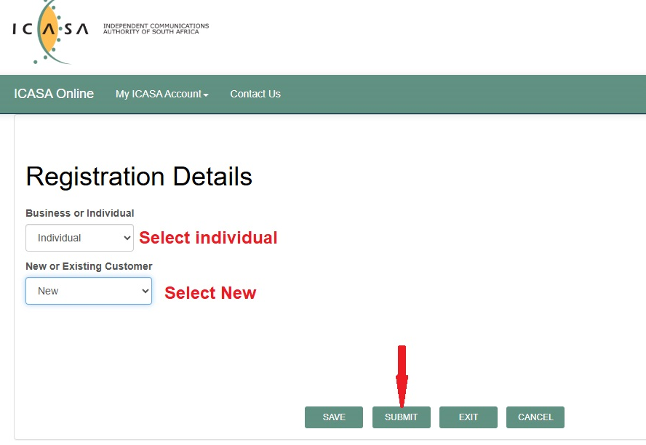
On this page select as indicated and click on “SUBMIT.”

Slide 10
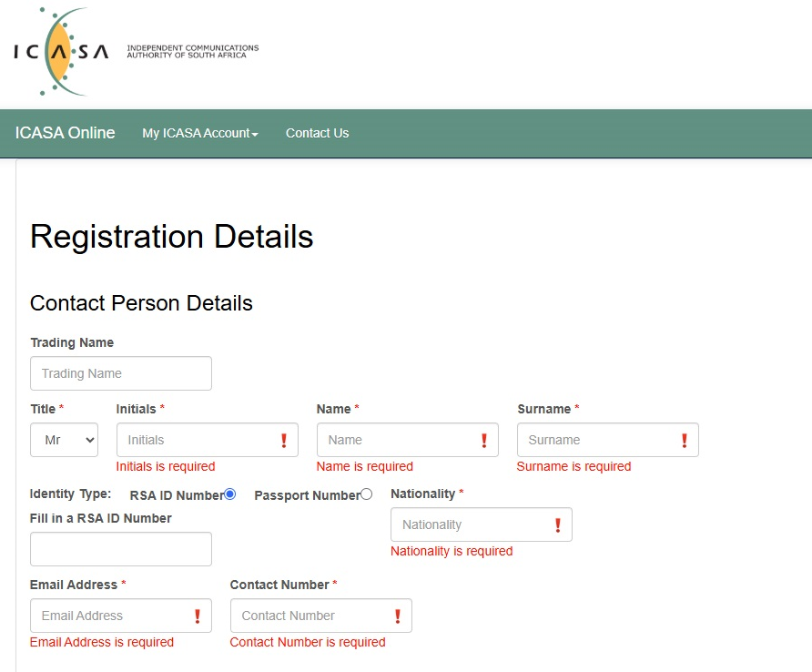
Now complete all your details as requested
Also select your title. (Mr is the default setting.)

Slide 11
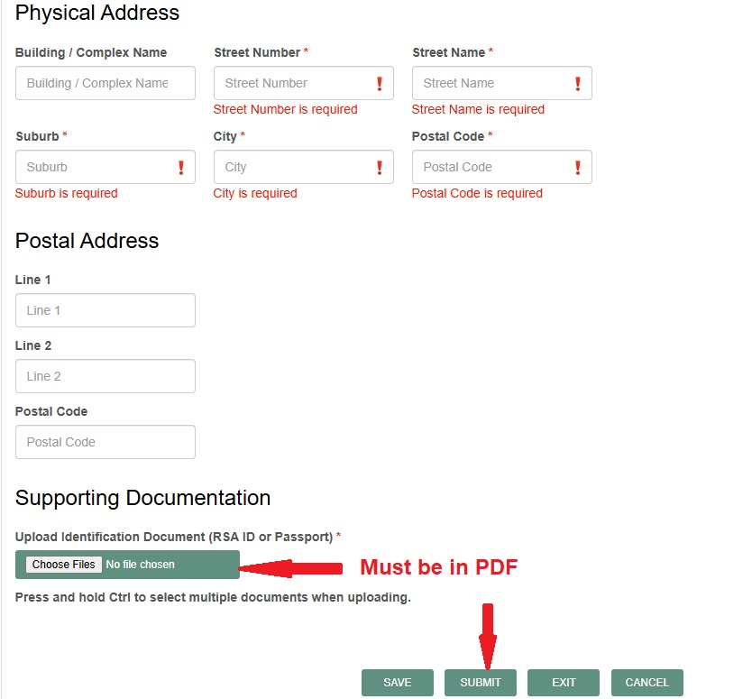
Continue with your details as requested.
Upload a PDF copy of your ID document/card or your passport.
Select “SUBMIT”

Slide 12
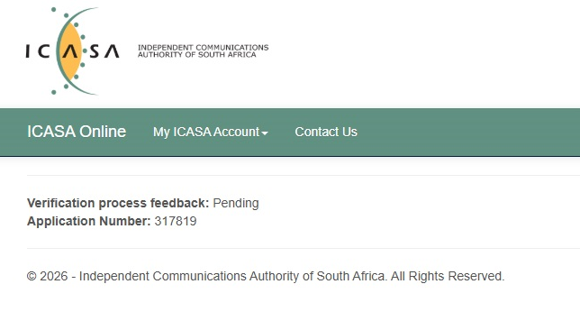
The following screen will now appear. Keep a record of your Application number.
Within a day or two, you will receive an email informing you that your account is now linked to the ICASA system.

Slide 13
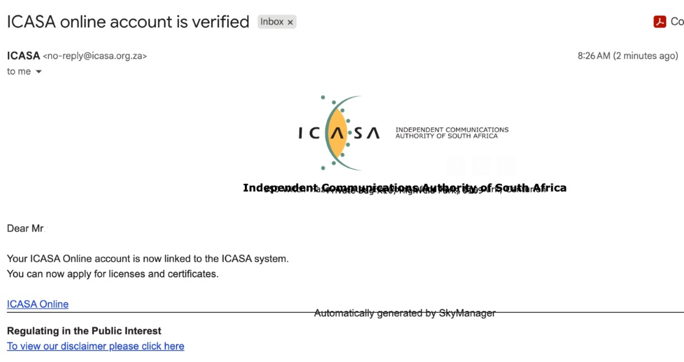
You will receive this email to confirm your registration.

Slide 14
A presentation on how to apply for your licence will follow soon.

