Slide 1

How to apply for your amateur radio licence on the ICASA website
Compiled by the SARL

Slide 2
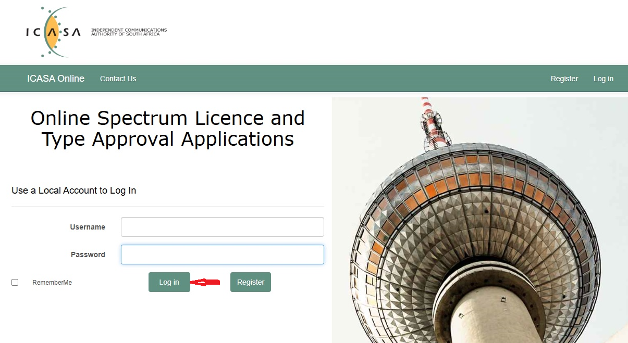
Click on “Log in”, enter your Username and Password and click “Log in” again.
https://online.icasa.org.za/

Slide 3
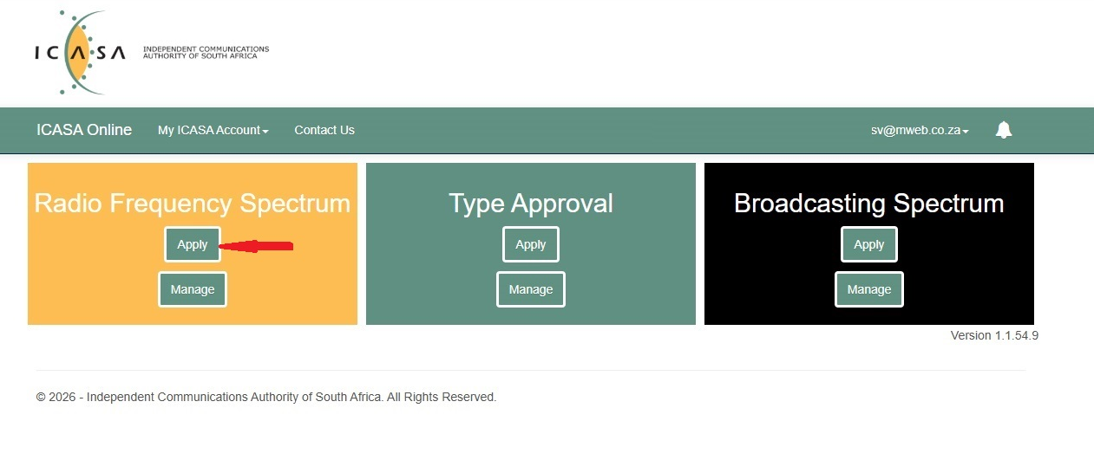
Click on Apply

Slide 4
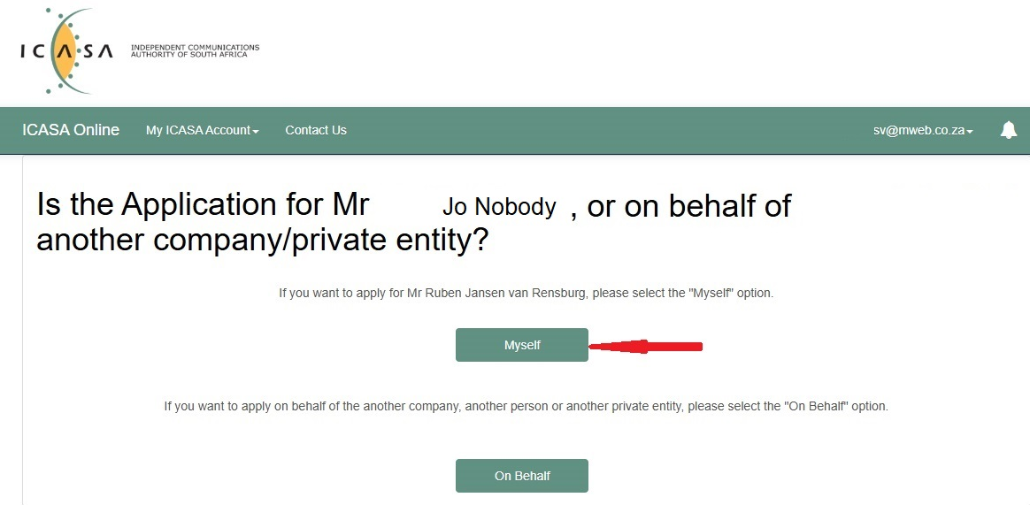
Select Myself

Slide 5
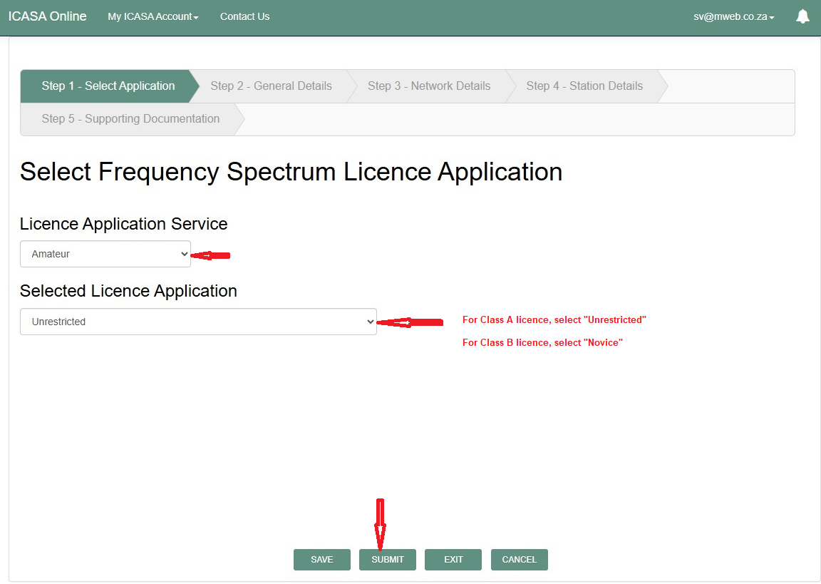
Select your service and type of licence and Submit

Slide 6
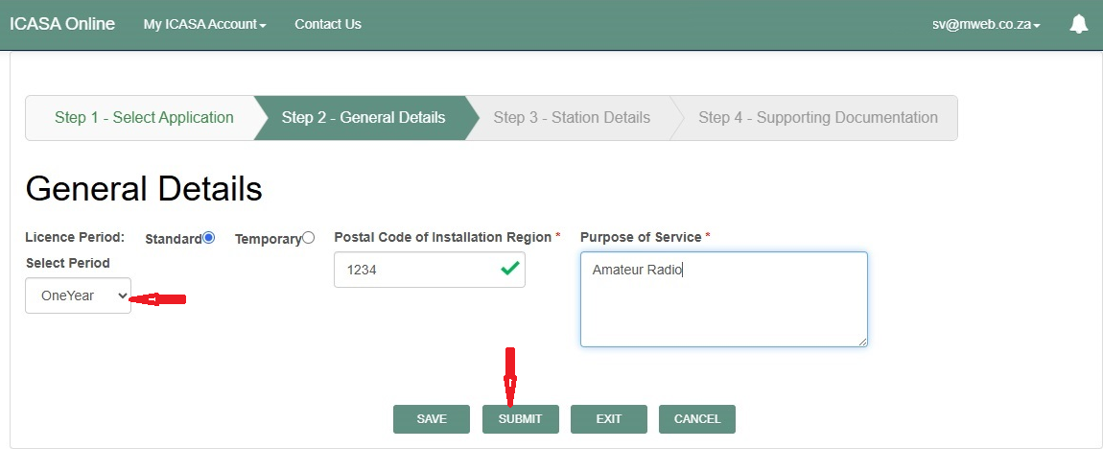
Select the term of your licence (normally for 1st application use “OneYear”).
The Postal Code is compulsory as ICASA will use that to determine your ICASA region

Slide 7
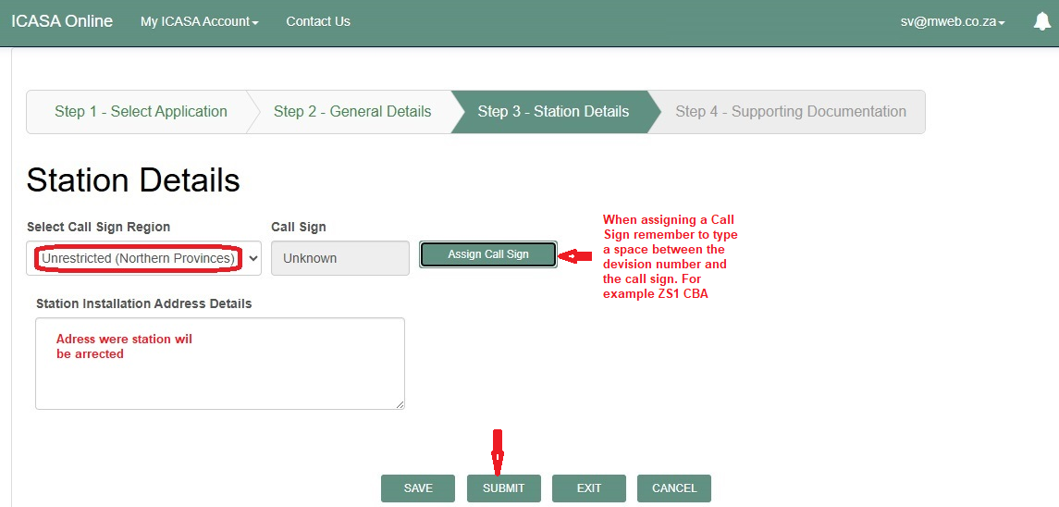
Select your Call Sign Region(ZS1 to ZS6), Complete your installation address.
Now select your call sign by typing ZS1 AAA or ZS2 BBB, etc. Only available call signs will appear.
Once you have selected your call sign click “Submit”.

Slide 8
To proceed you will need your HAREC certificate and HF Operating certificate which is issued by the SARL once you have passed the RAE and HF operating test.

Slide 9
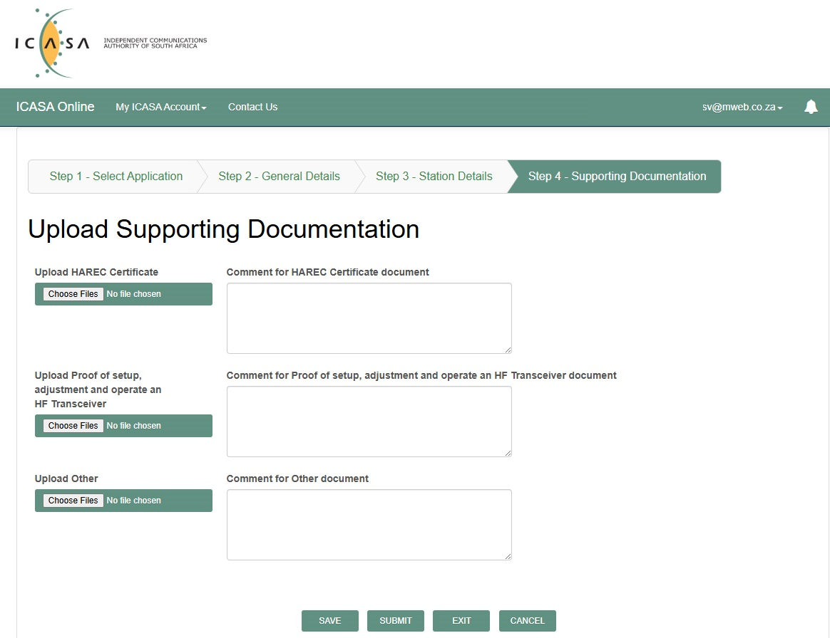

Upload your HAREC and HF certificate and SUBMIT
N/A

Slide 10
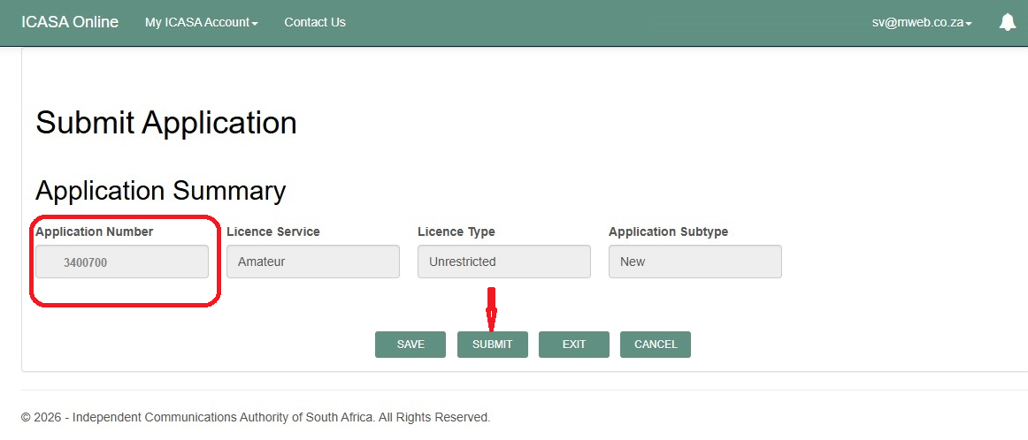
Make a note of your Application Number and click SUBMIT

Slide 11
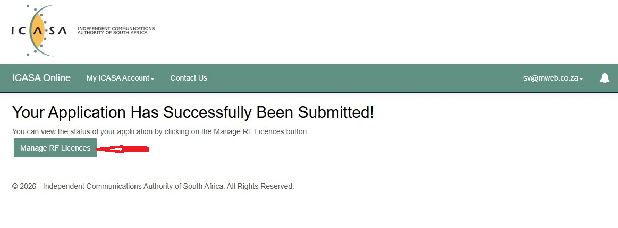
Click on “Manage RF Licences” to proceed to paying your application fee.

Slide 12
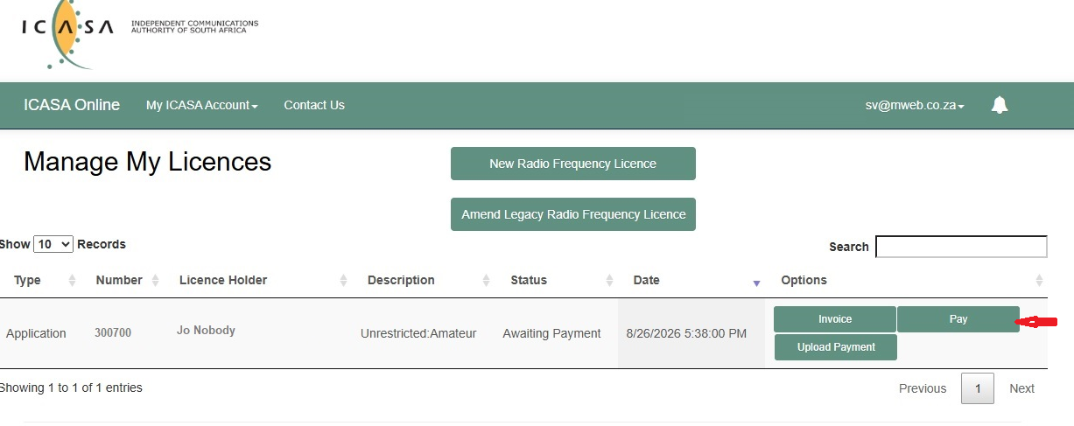
The best option is to Pay by Debit or Credit card as it will speed up the process
but there is also the option to download the Invoice, Pay by EFT and upload the PoP. The SARL highly recommend paying by card.

Slide 13
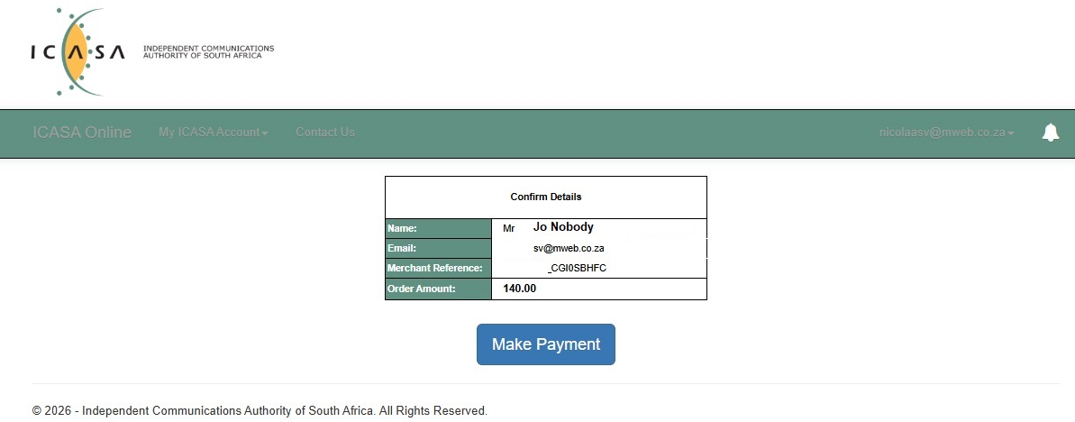
The amount indicated is for the Licence Application fee.
To proceed click on “Make Payment”.

Slide 14
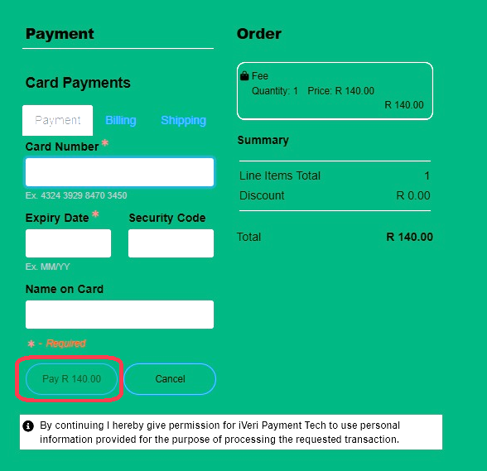
Supply the required information and complete the payment.

Slide 15
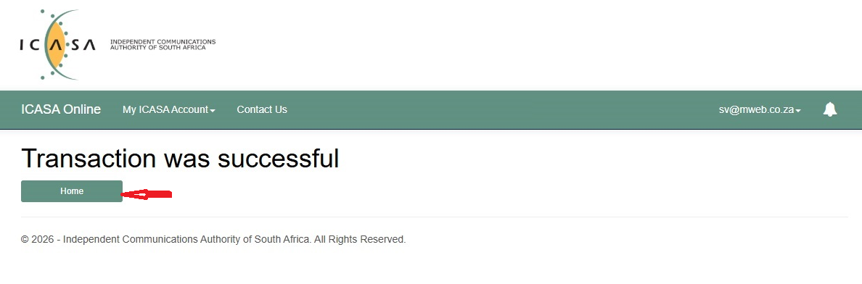
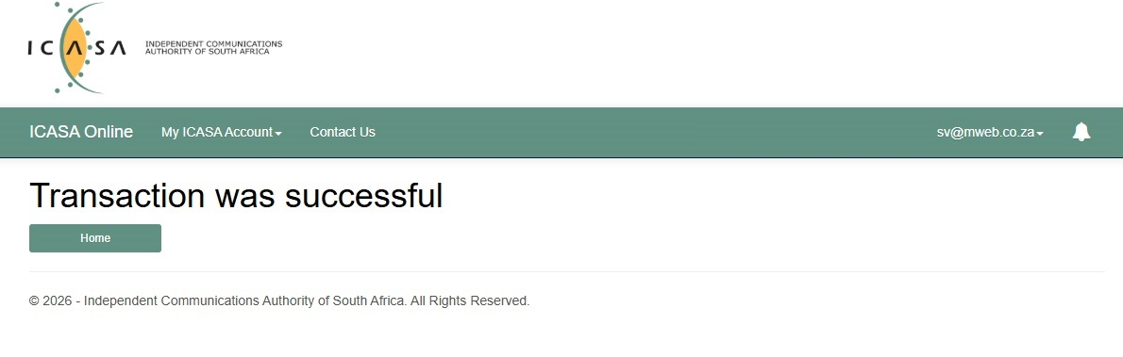
Once you see this screen, click on “Home” to proceed to the next screen.

Slide 16
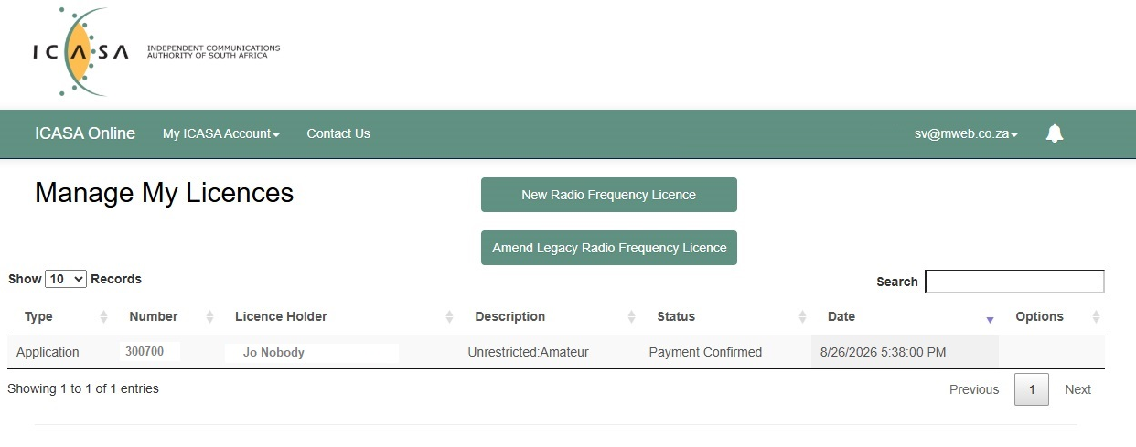
Payment for the licence application is now completed.
It will now take a day or two before ICASA will respond by requesting payment for the actual licence.

Slide 17
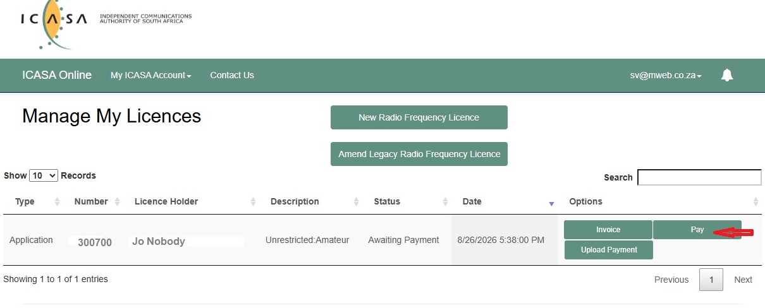
This screen will now appear requesting payment for the actual licence.
The preferred method of payment is by Debit or Credit card.

Slide 18
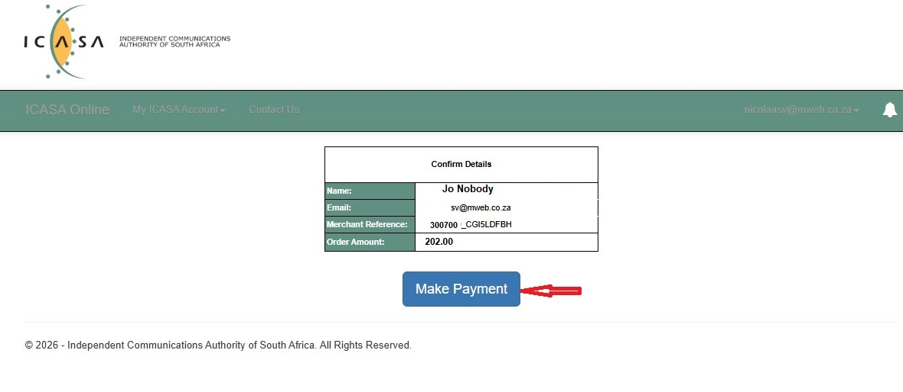
The amount indicated is for the Actual licence.
To proceed click on “Make Payment”.

Slide 19
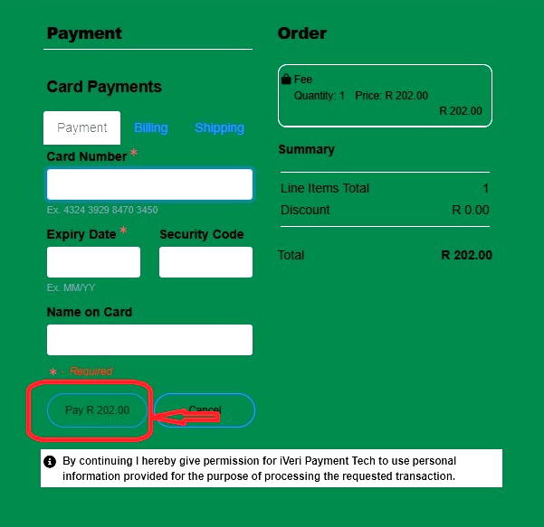
Supply the required information and complete the payment.

Slide 20
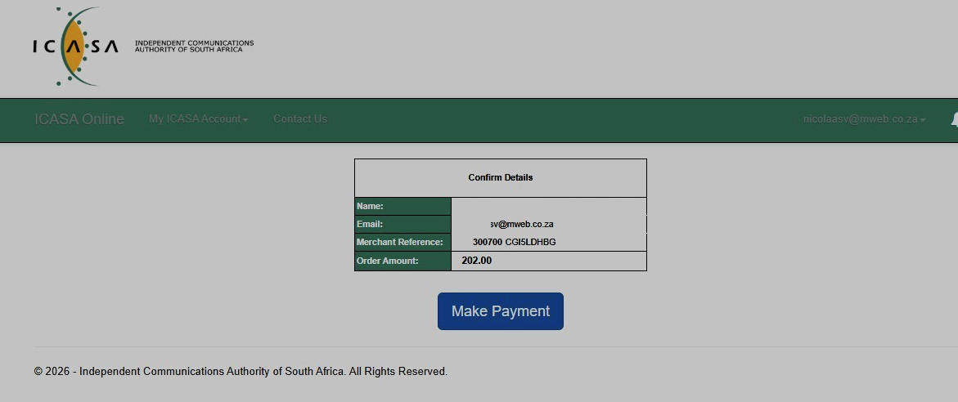
This screen will appear and you can click on “Make Payment”.

Slide 21
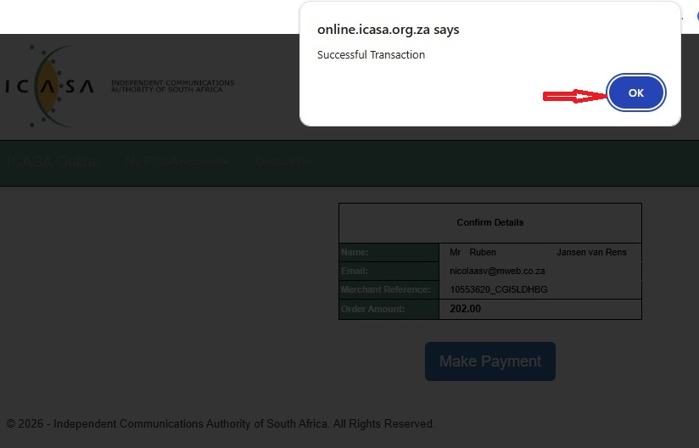
Wait for this screen and click on “OK”.

Slide 22
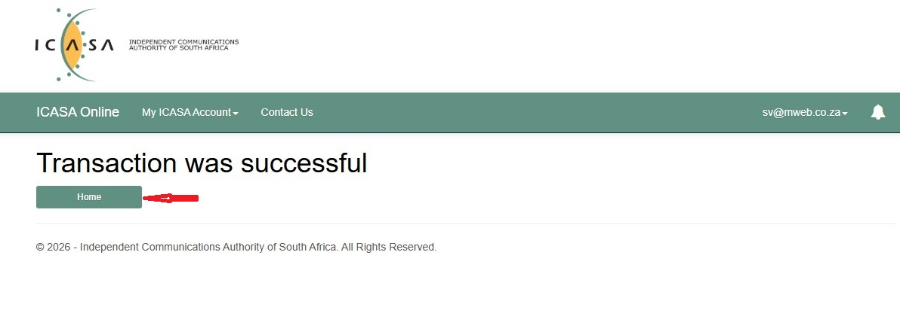
Once this screen appears, Click on “Home”.

Slide 23
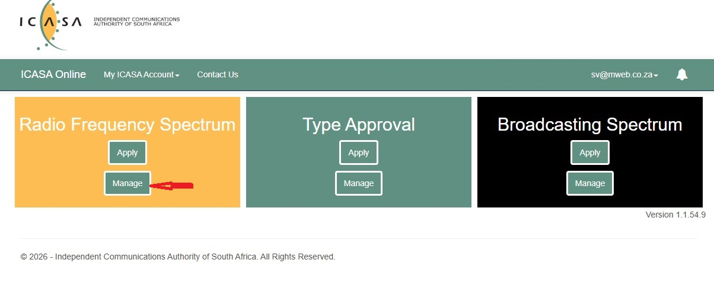
Select “Manage” to proceed to down loading your licence.

Slide 24
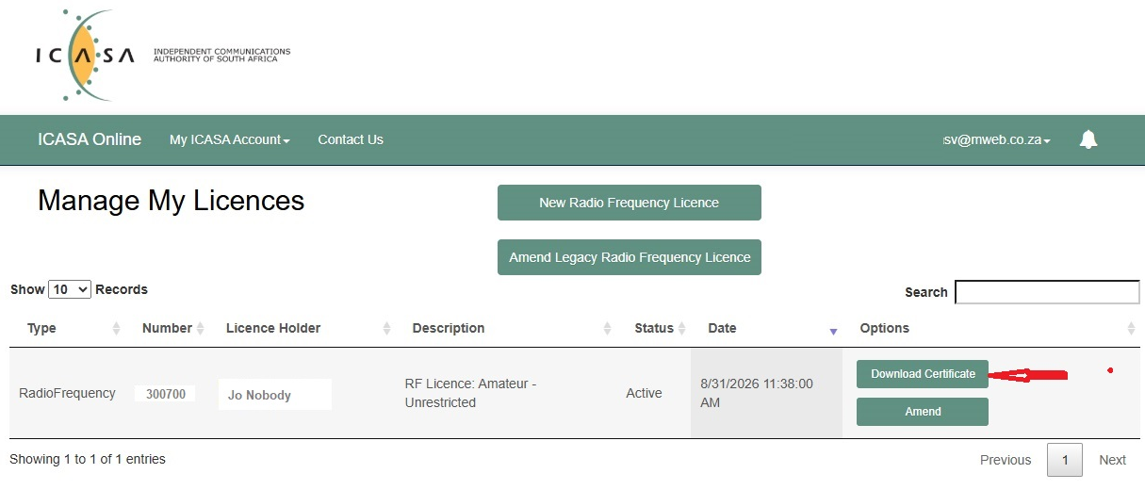
You can now download your licence!

Slide 25
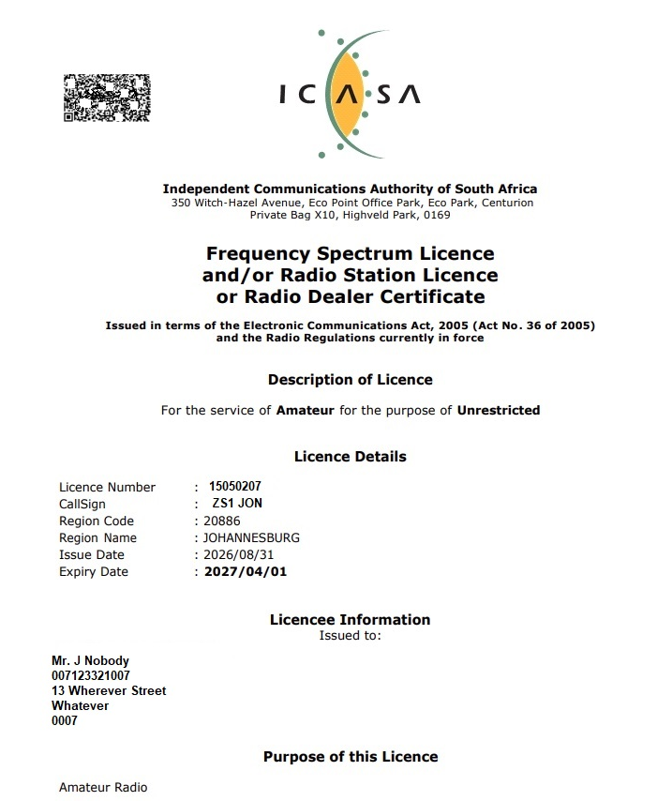
Welcome on the Air!

